Slide 1
Data Wrangling on a set of datasets
Name: Priti Mohan kalaskar
Organization: Nexthikes IT Solutions

Slide 2
Datasets Overview
No of Datasets:
3 (Dataset_1, Dataset_2, Dataset_3)
No of Merged Datasets:
2 (Dataset_A, Dataset_B)
Dataset_A:
Merged from Dataset_1 and Dataset_2
Dataset_B:
Merged from Dataset_A and Dataset_3

Slide 3
Steps followed for Data Wrangling
• Load Dataset
• Data Preprocessing
- Missing values
- Duplicate Values
- Unnecessary columns
- Data Types
• EDA
- Visualisations
- Correlation (for Dataset_B)
- Outliers (for Dataset_B)
- Skewness and Kurtosis (for Dataset_B)

Slide 4
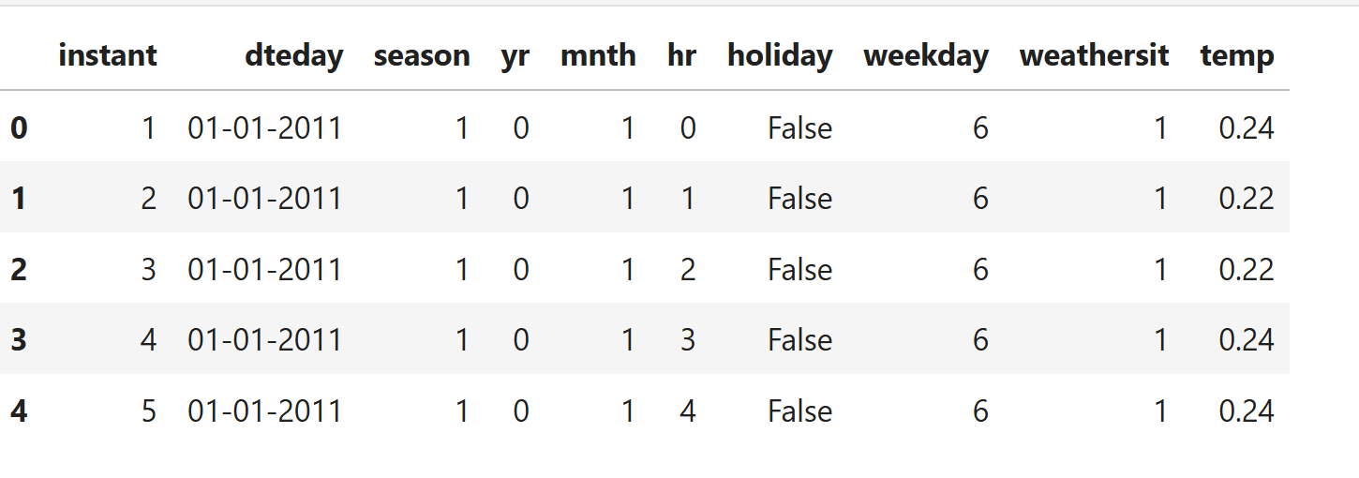
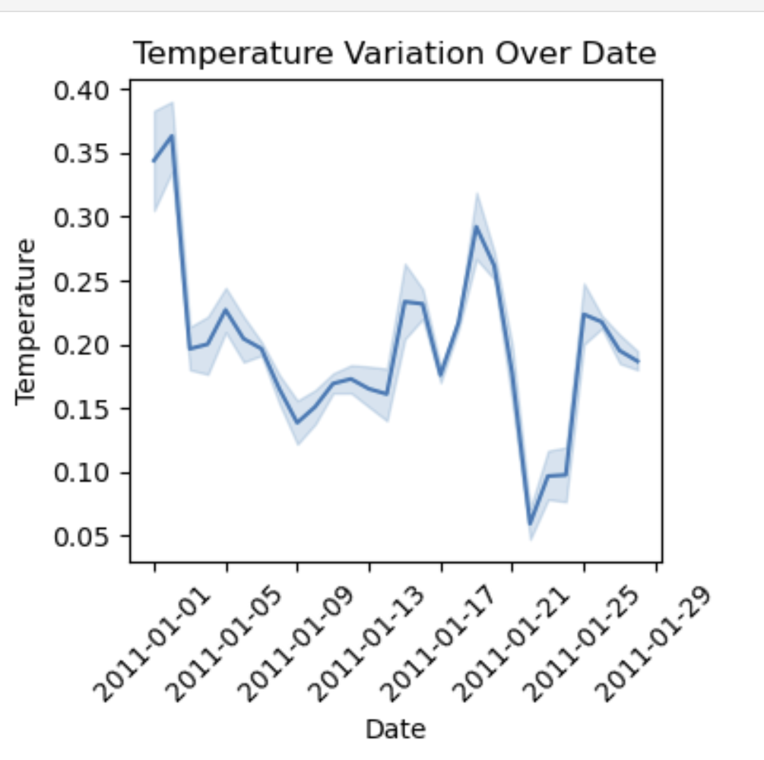
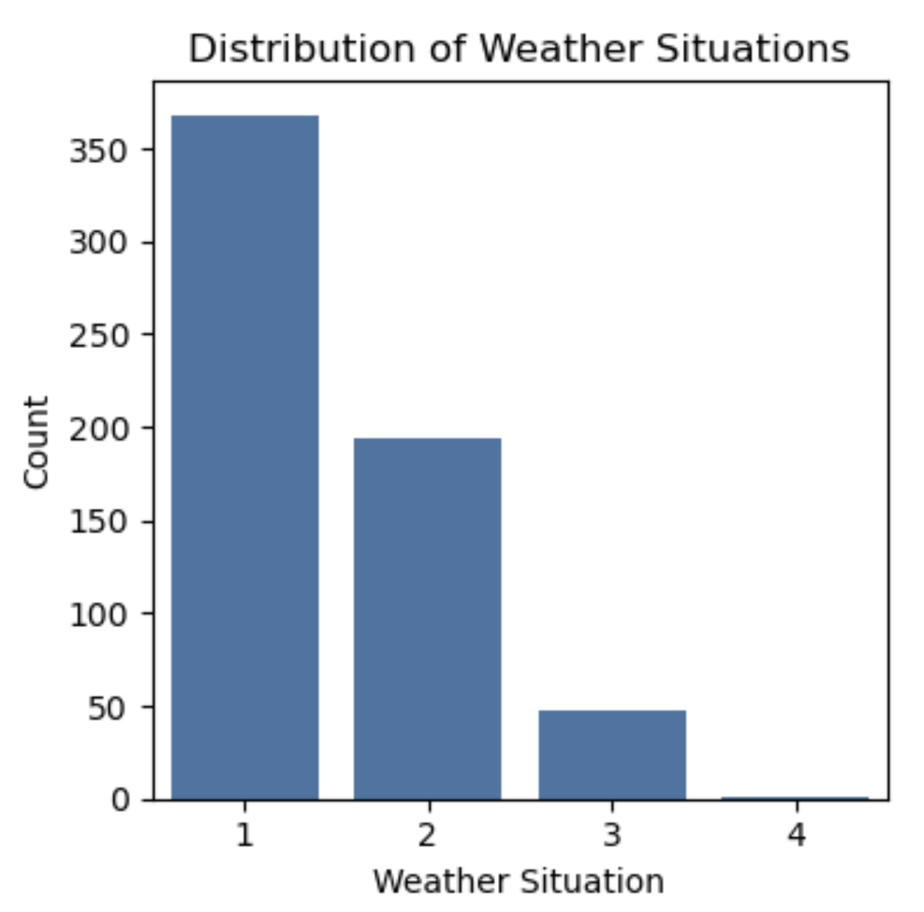
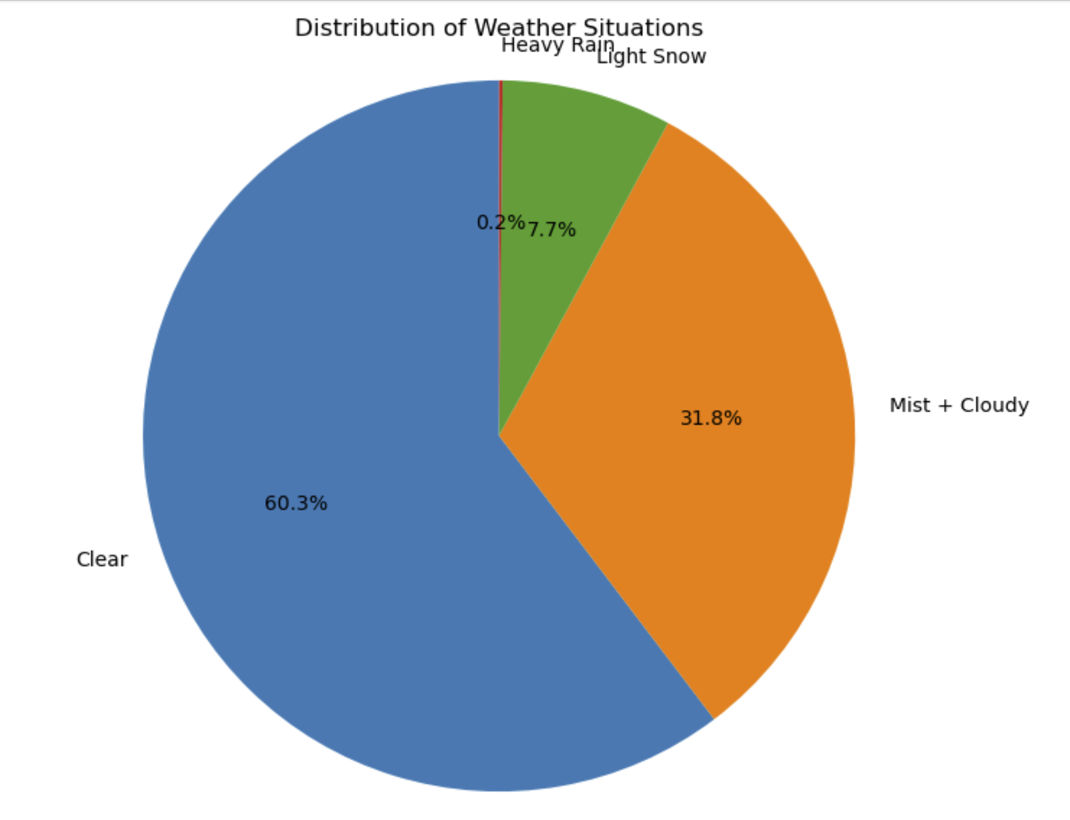
Dataset_1
Dataset:
Visualizations:

Slide 5
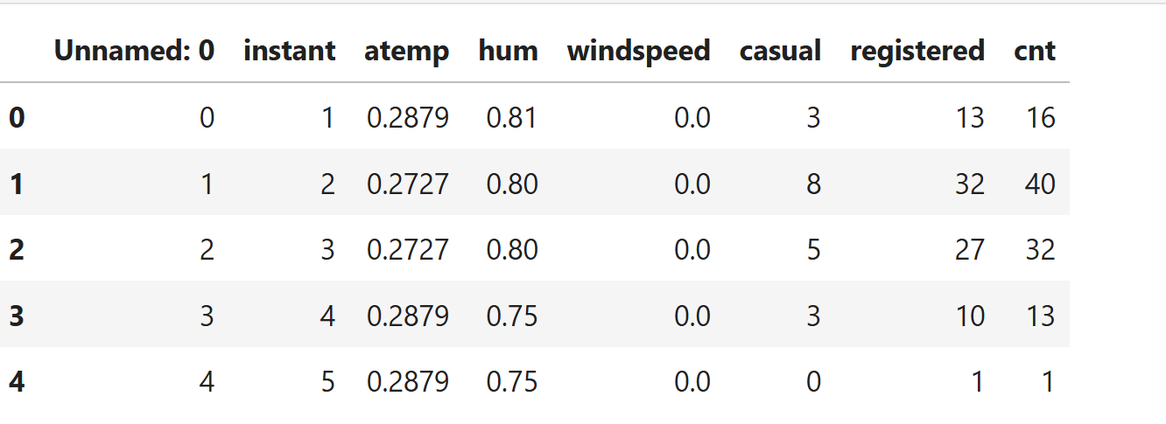
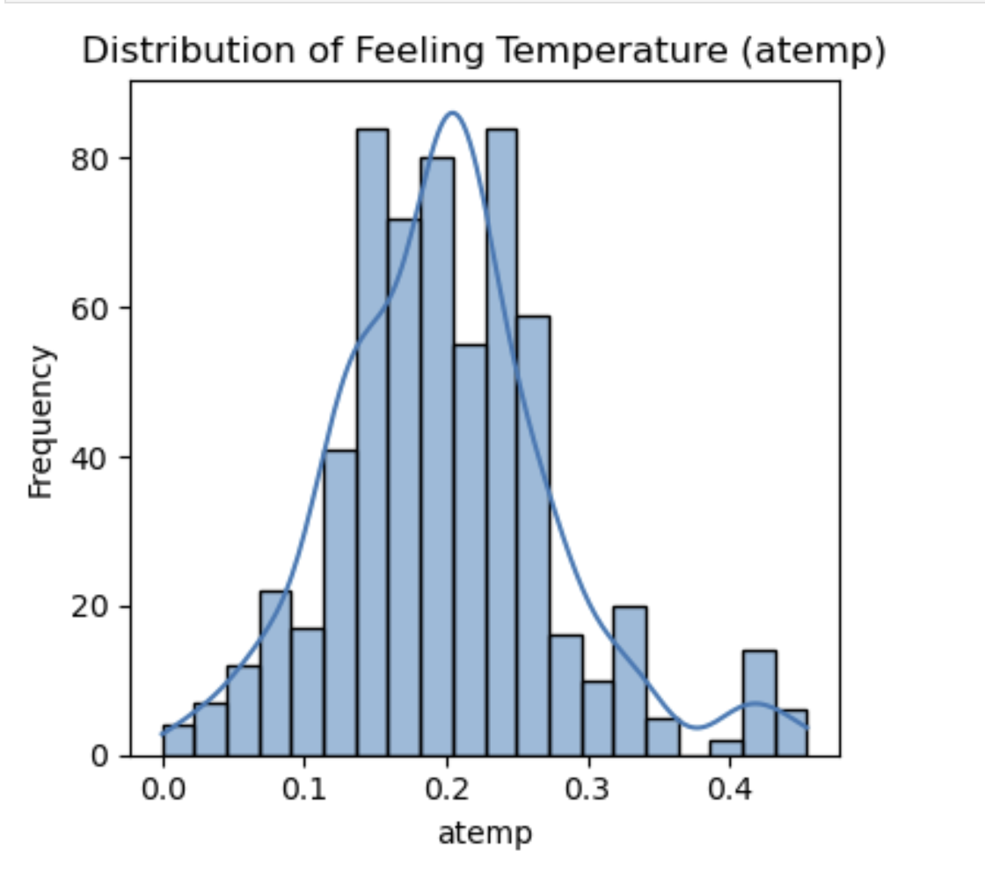
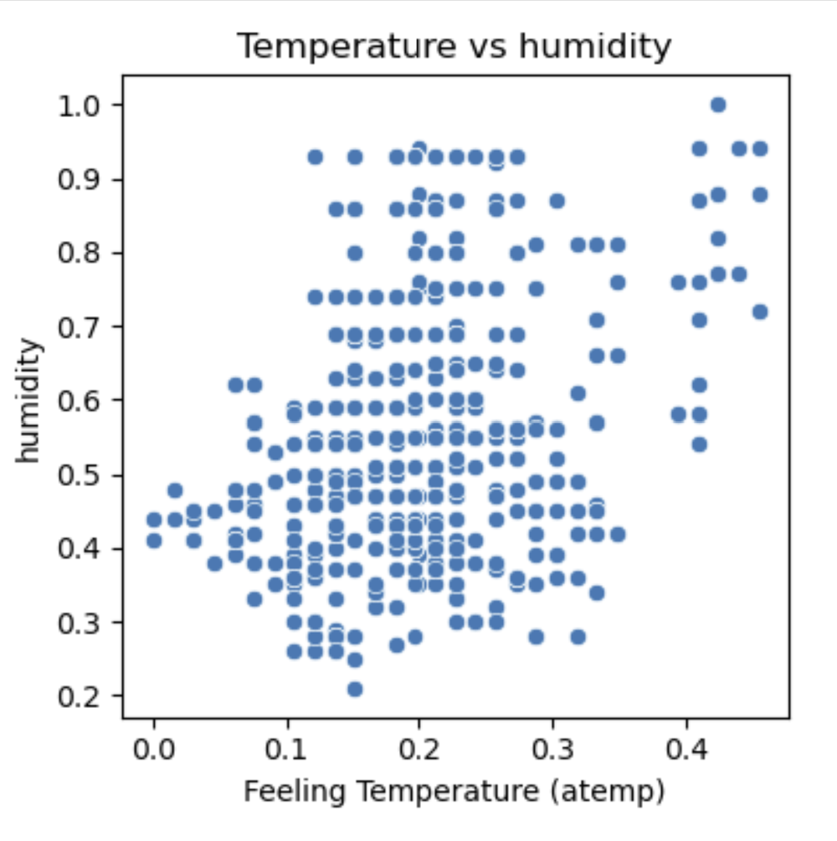
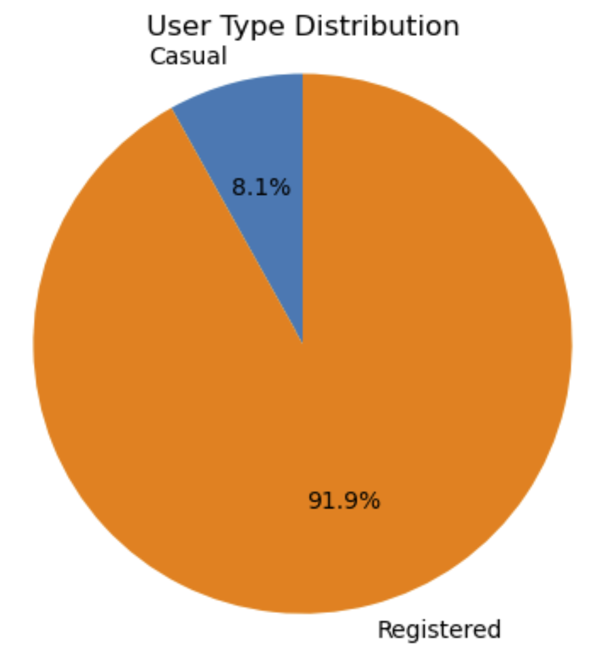
Dataset_2
Dataset:
Visualizations:

Slide 6
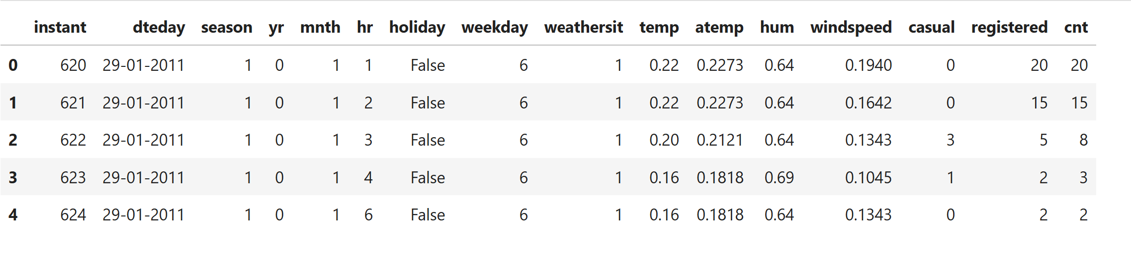
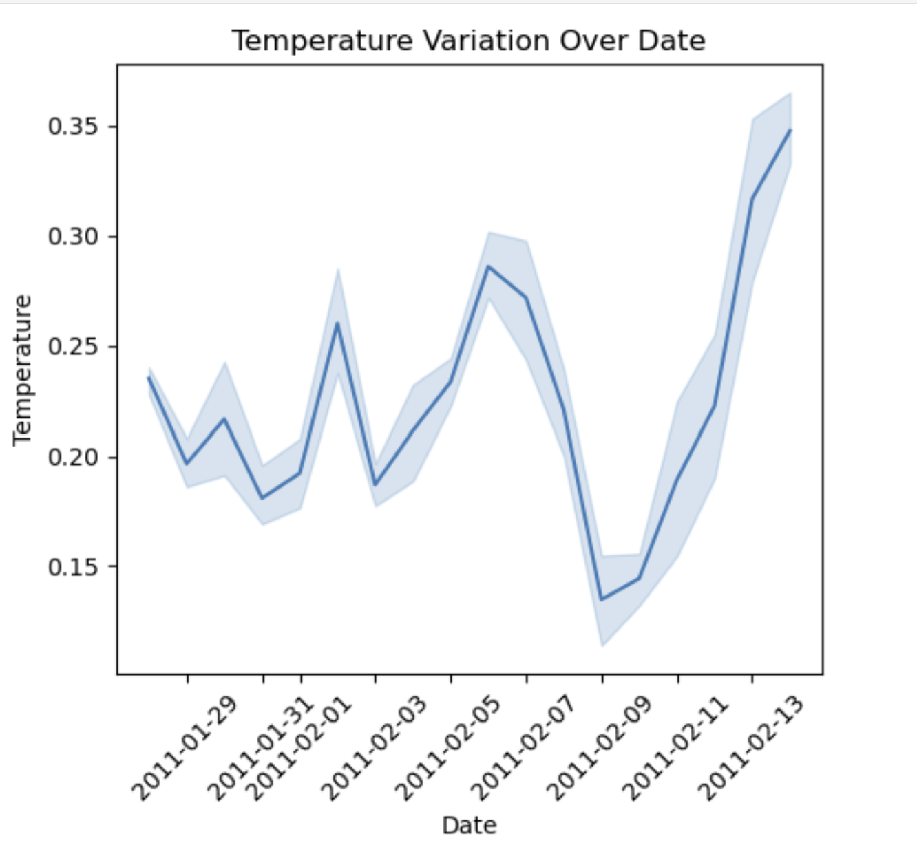
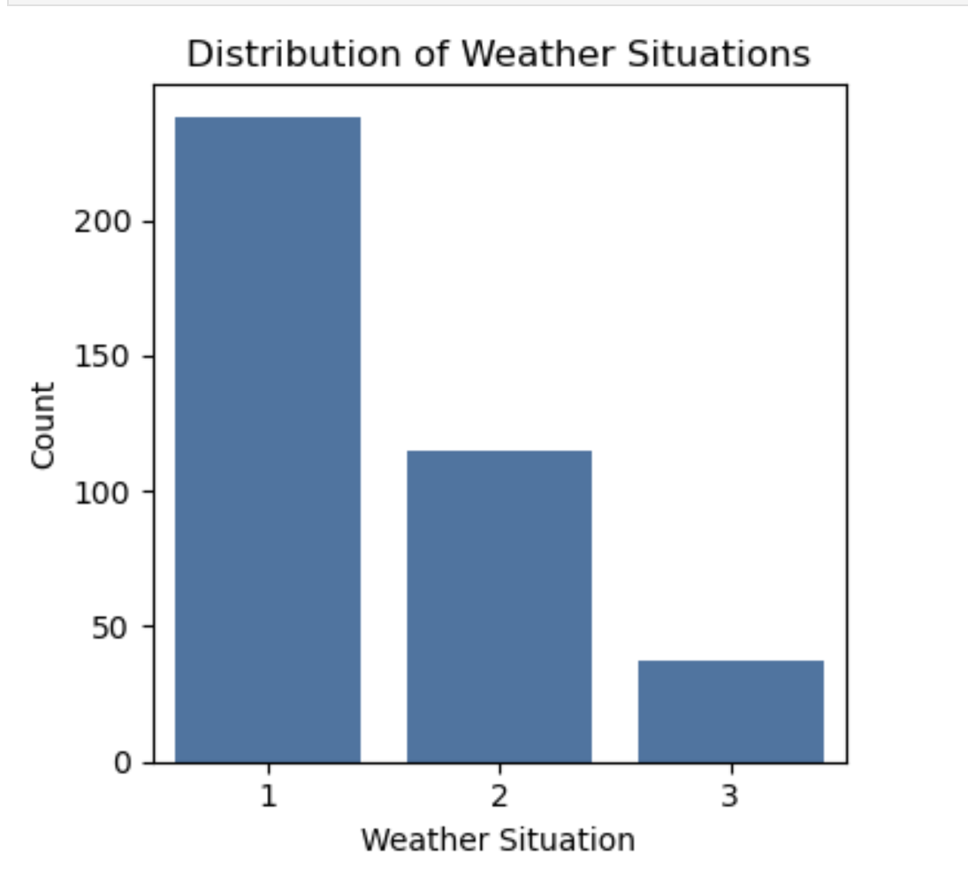
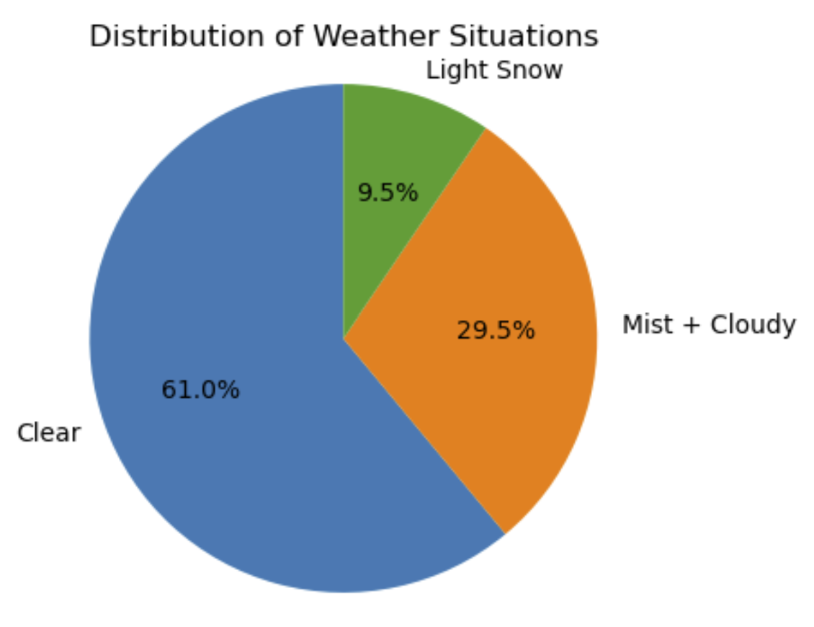
Dataset_3
Dataset:
Visualizations:

Slide 7
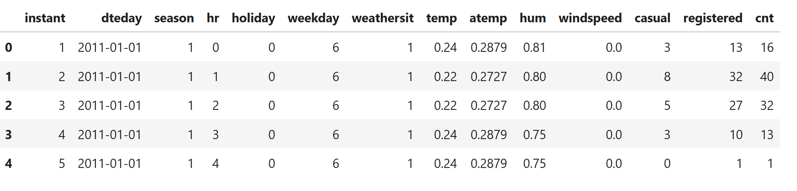
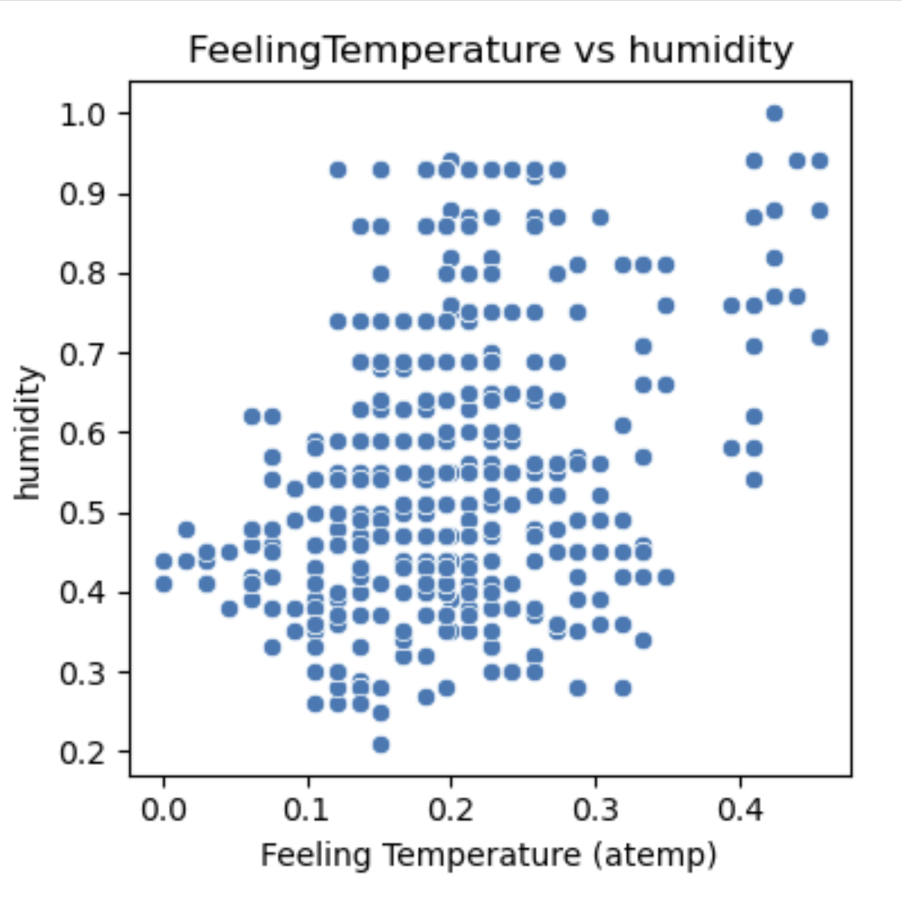
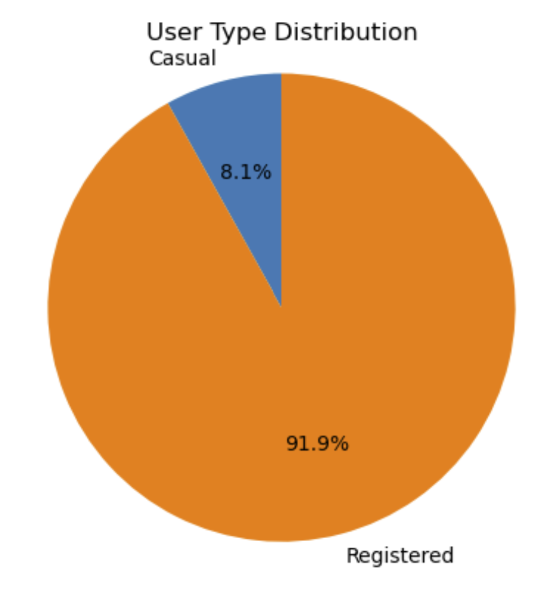
Dataset_A
Dataset_A(Merged from Dataset_1 and Dataset_2):
Visualizations:

Slide 8
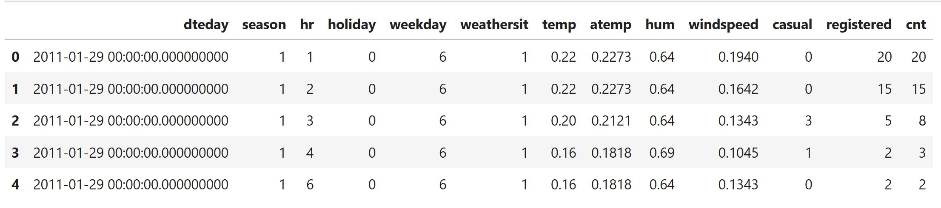
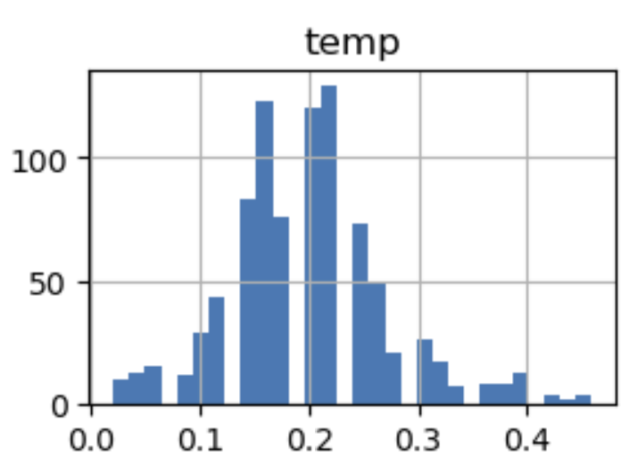
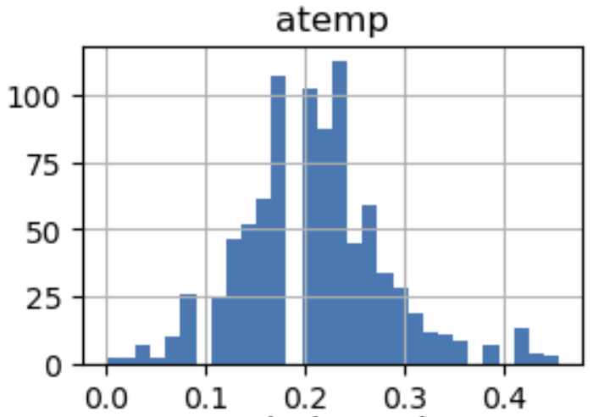
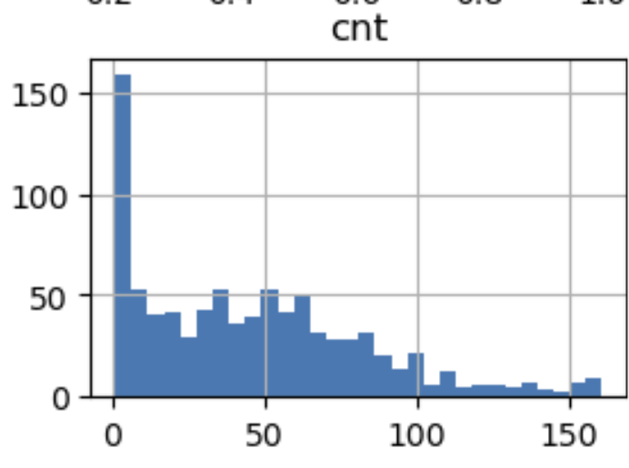
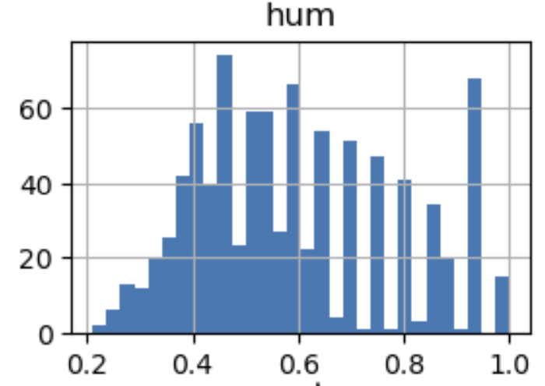
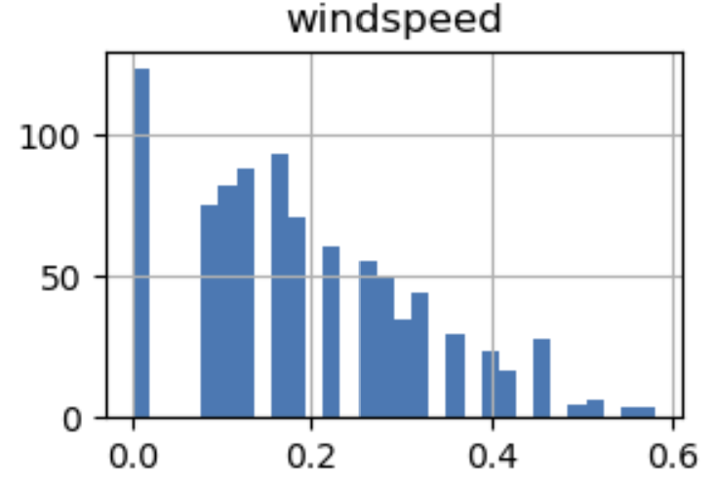
Dataset_B
Final Dataset_B (Merged from Dataset_3 and Dataset_A):
Visualizations: Histograms of Numeric Features

Slide 9
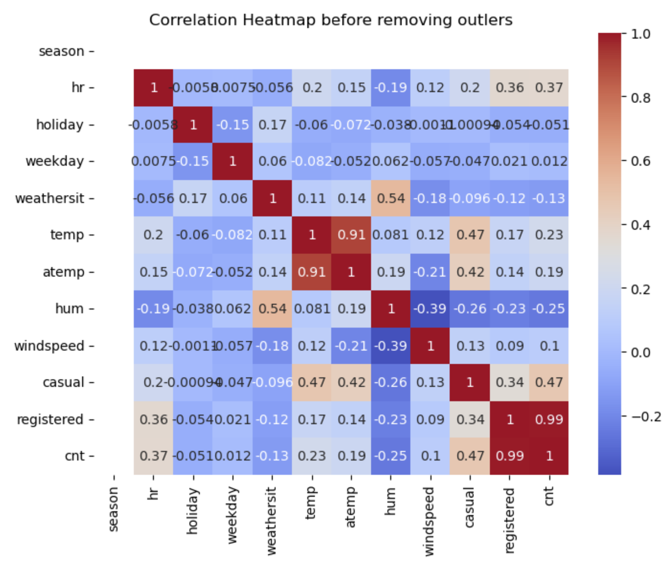
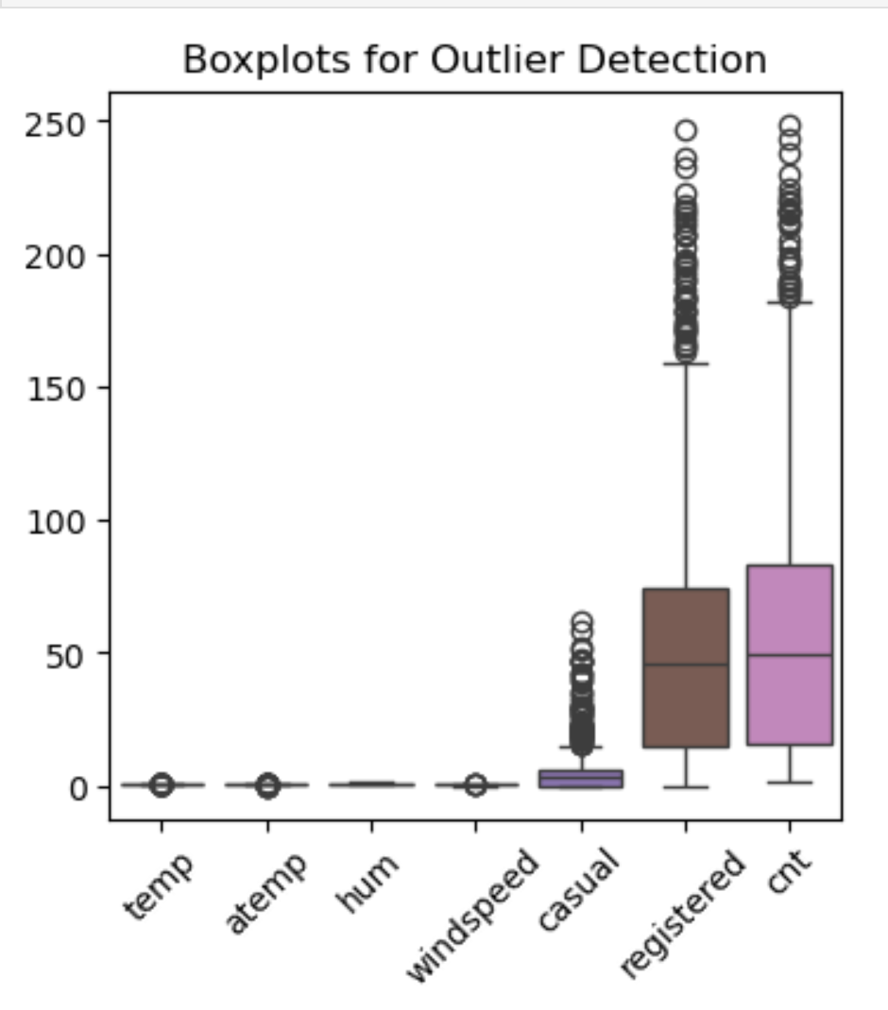
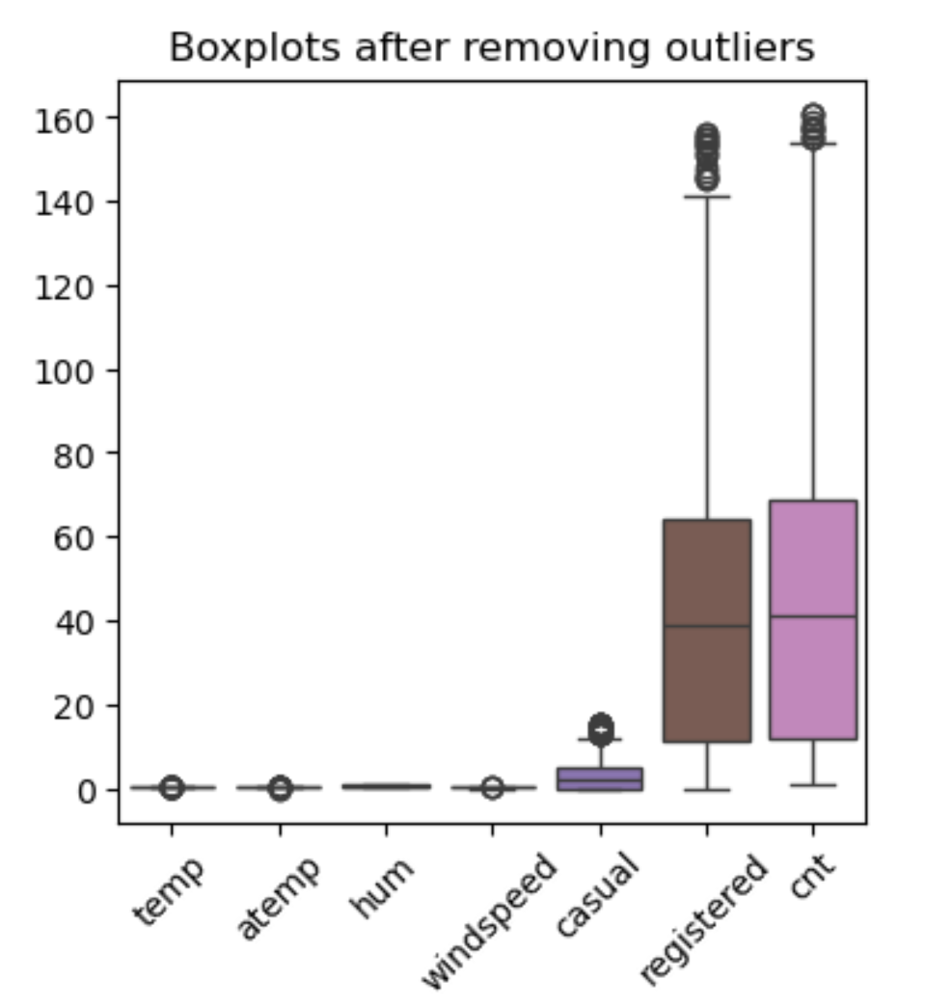
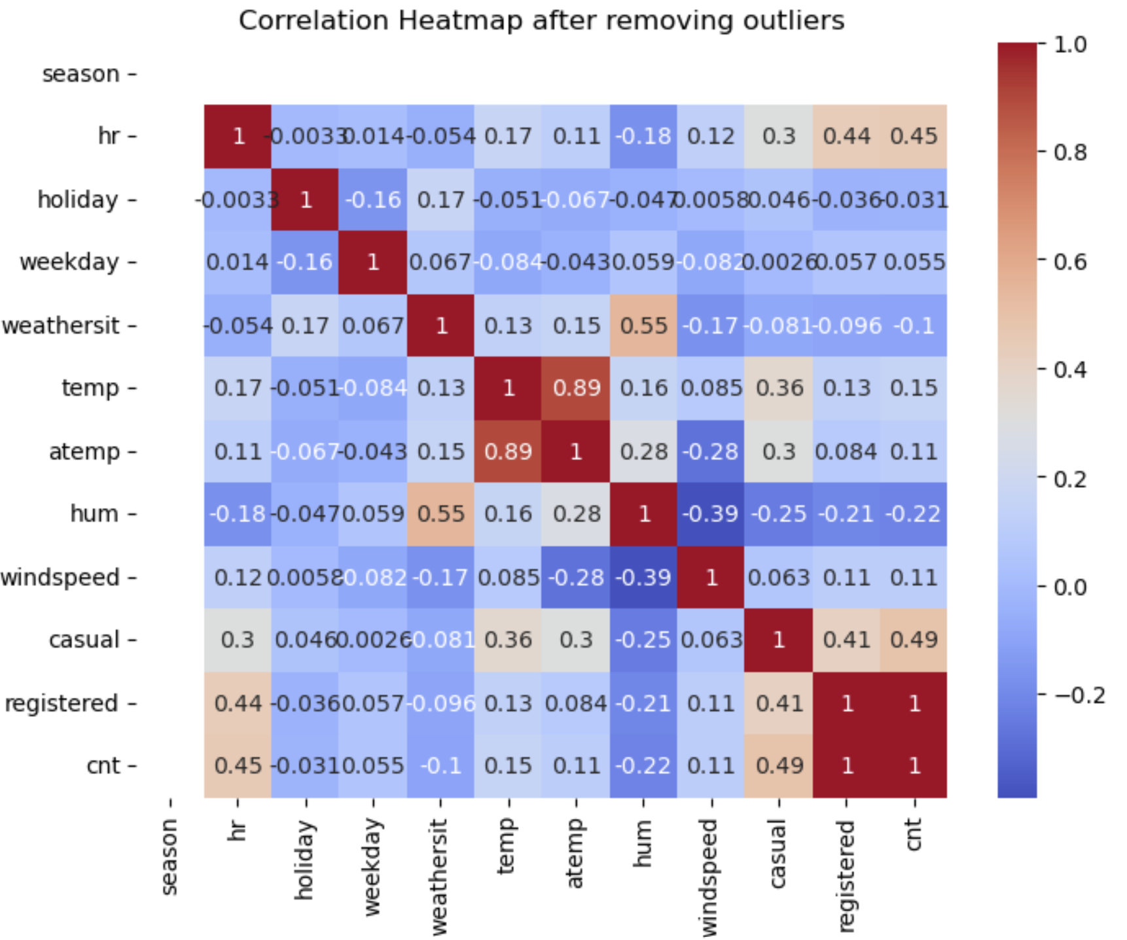
Correlation and Outliers

Slide 10
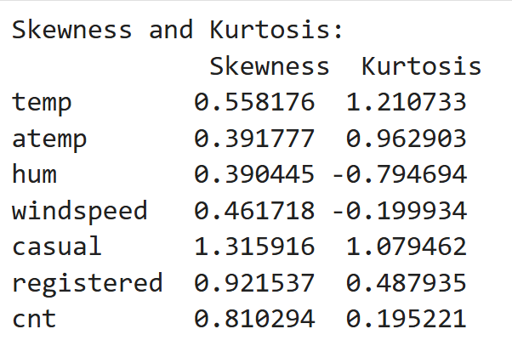
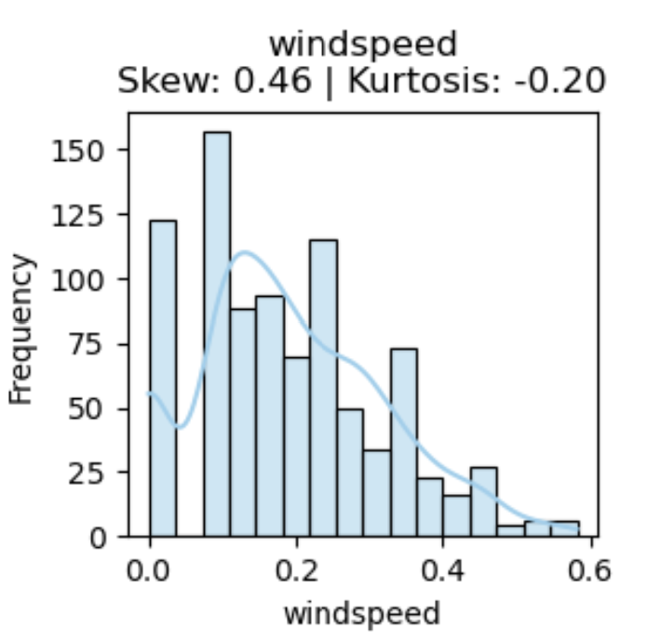
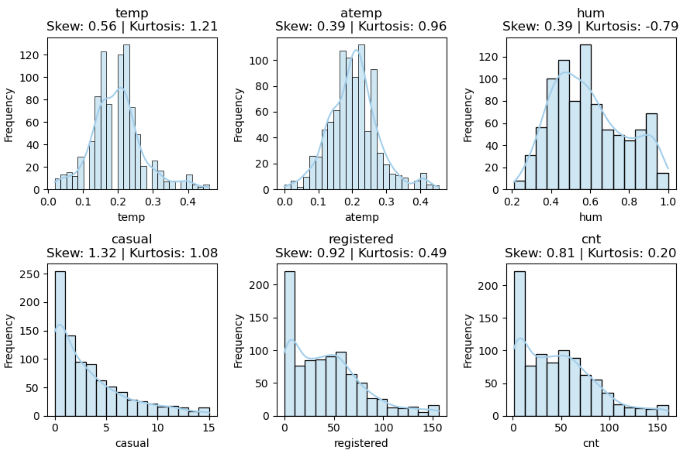
Skewness and Kurtosis

Slide 11
Thank You
Thank you for your time and attention!
Suggestions and feedback are welcome.

